Slide 1
Factors affecting income
Yuwei Zhang

Slide 2
Introduction
annual income <=$50k >$50k
(1|country)
age
sex
race
relationship
(marriage)
education
occupation
work hours
capital
Key Questions
main factors that have an impact on income?
more likely to have an annual income of > $50K with greater age?
any other interesting relationships?

Slide 3
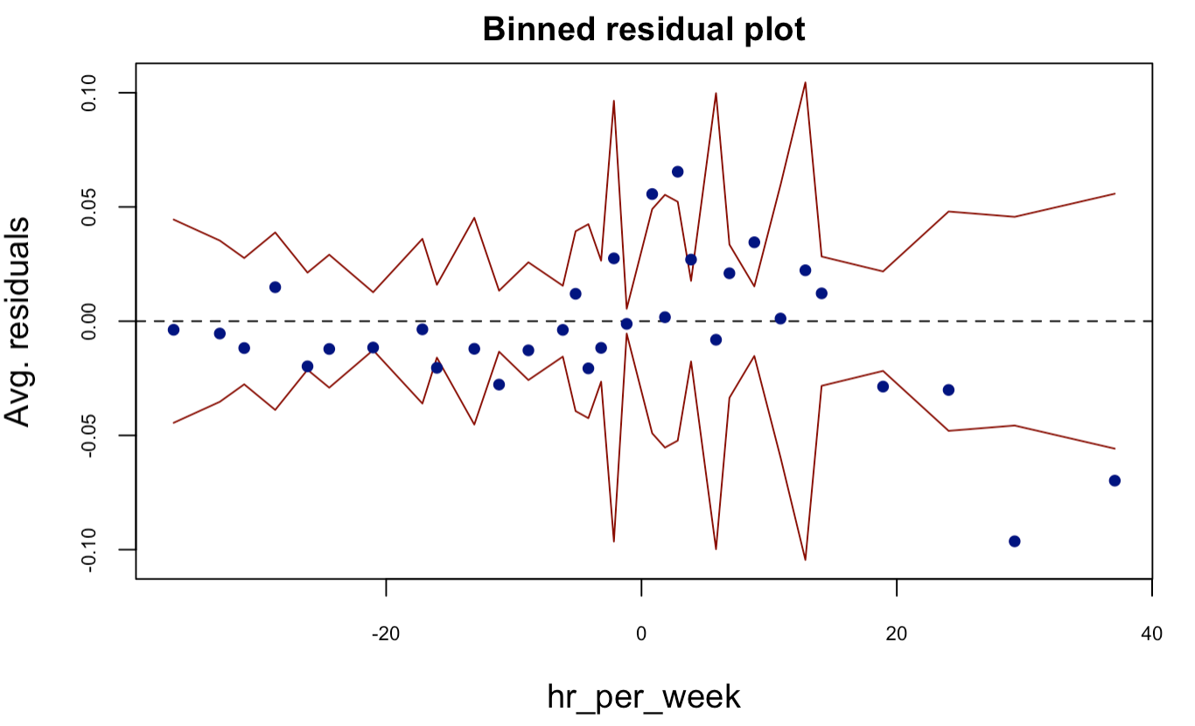
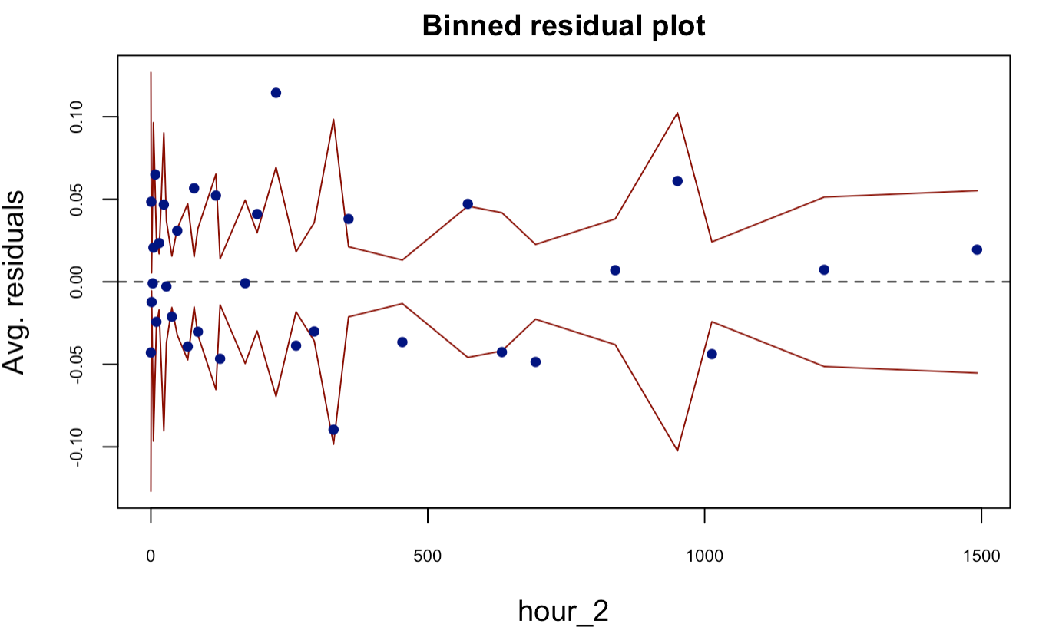
EDA
Individual
Numerical Variables
age → young, middle, senior, old (25, 45, 65)
capital gain & loss → capital
hours per week → centralized + square
Categorical Variable
education → ‘No HS-grad’, ‘HS-grad’, ‘College’, ‘Bachelors’, 'Masters+’
relationship → ‘Married’, ‘Unmarried’, ‘Own-child’
All categorical variables have significant relationship with income
Interactions
Possible interactions
age*(relationship + education + occupation + hours per week)
education : sex

Slide 4
Model
Preliminary Model
native country as random intercept
logistic regression
Assumptions
Chi-squared Test
Interactions
Binned Residual Plot : randomness
Multicollinearity, outliers
1
2
3
Final Model
income_50k ~ age + sex + race + relationship + education +
capital + occupation + hr_per_week + hour_2 +
age *(relationship + occupation + hr_per_week) + (1|country)

Slide 5


Results
Baseline: married young women coming from India, with a bachelor’s degree and working as a clerk
education, capital gain, occupation
relationship → unmarried, own-child
age: middle ↑23% | senior 68%↓, old 13%↓
working hours & square of working hours

Slide 6
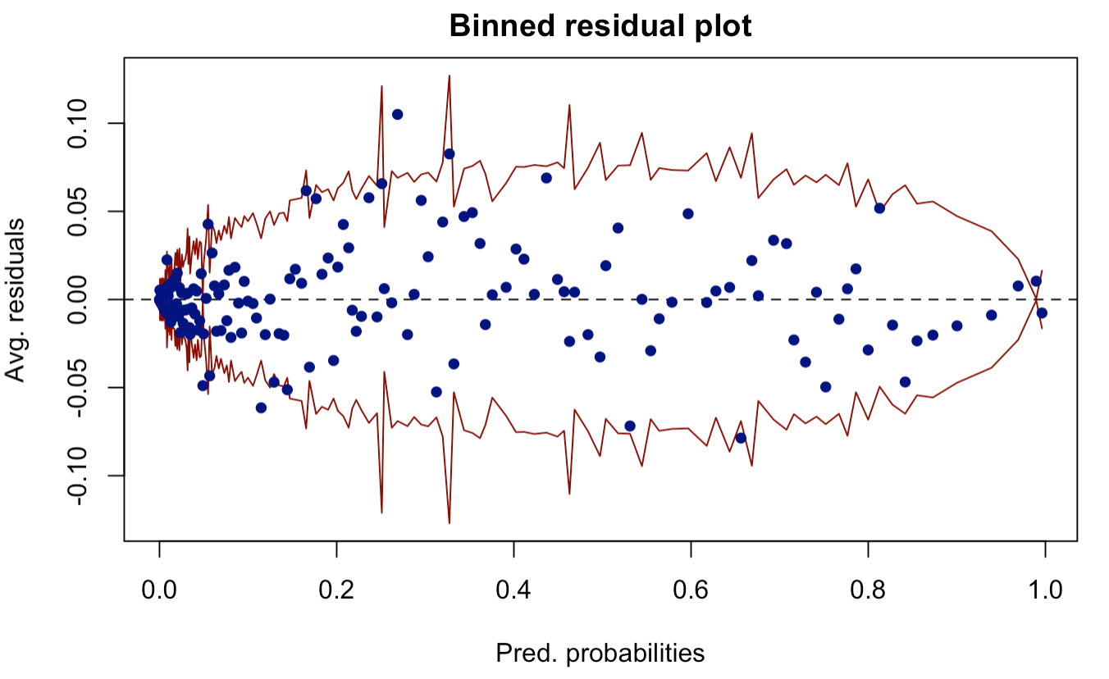
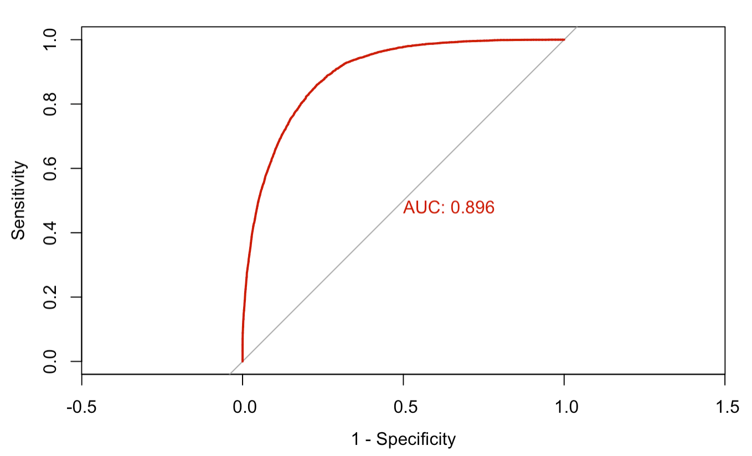
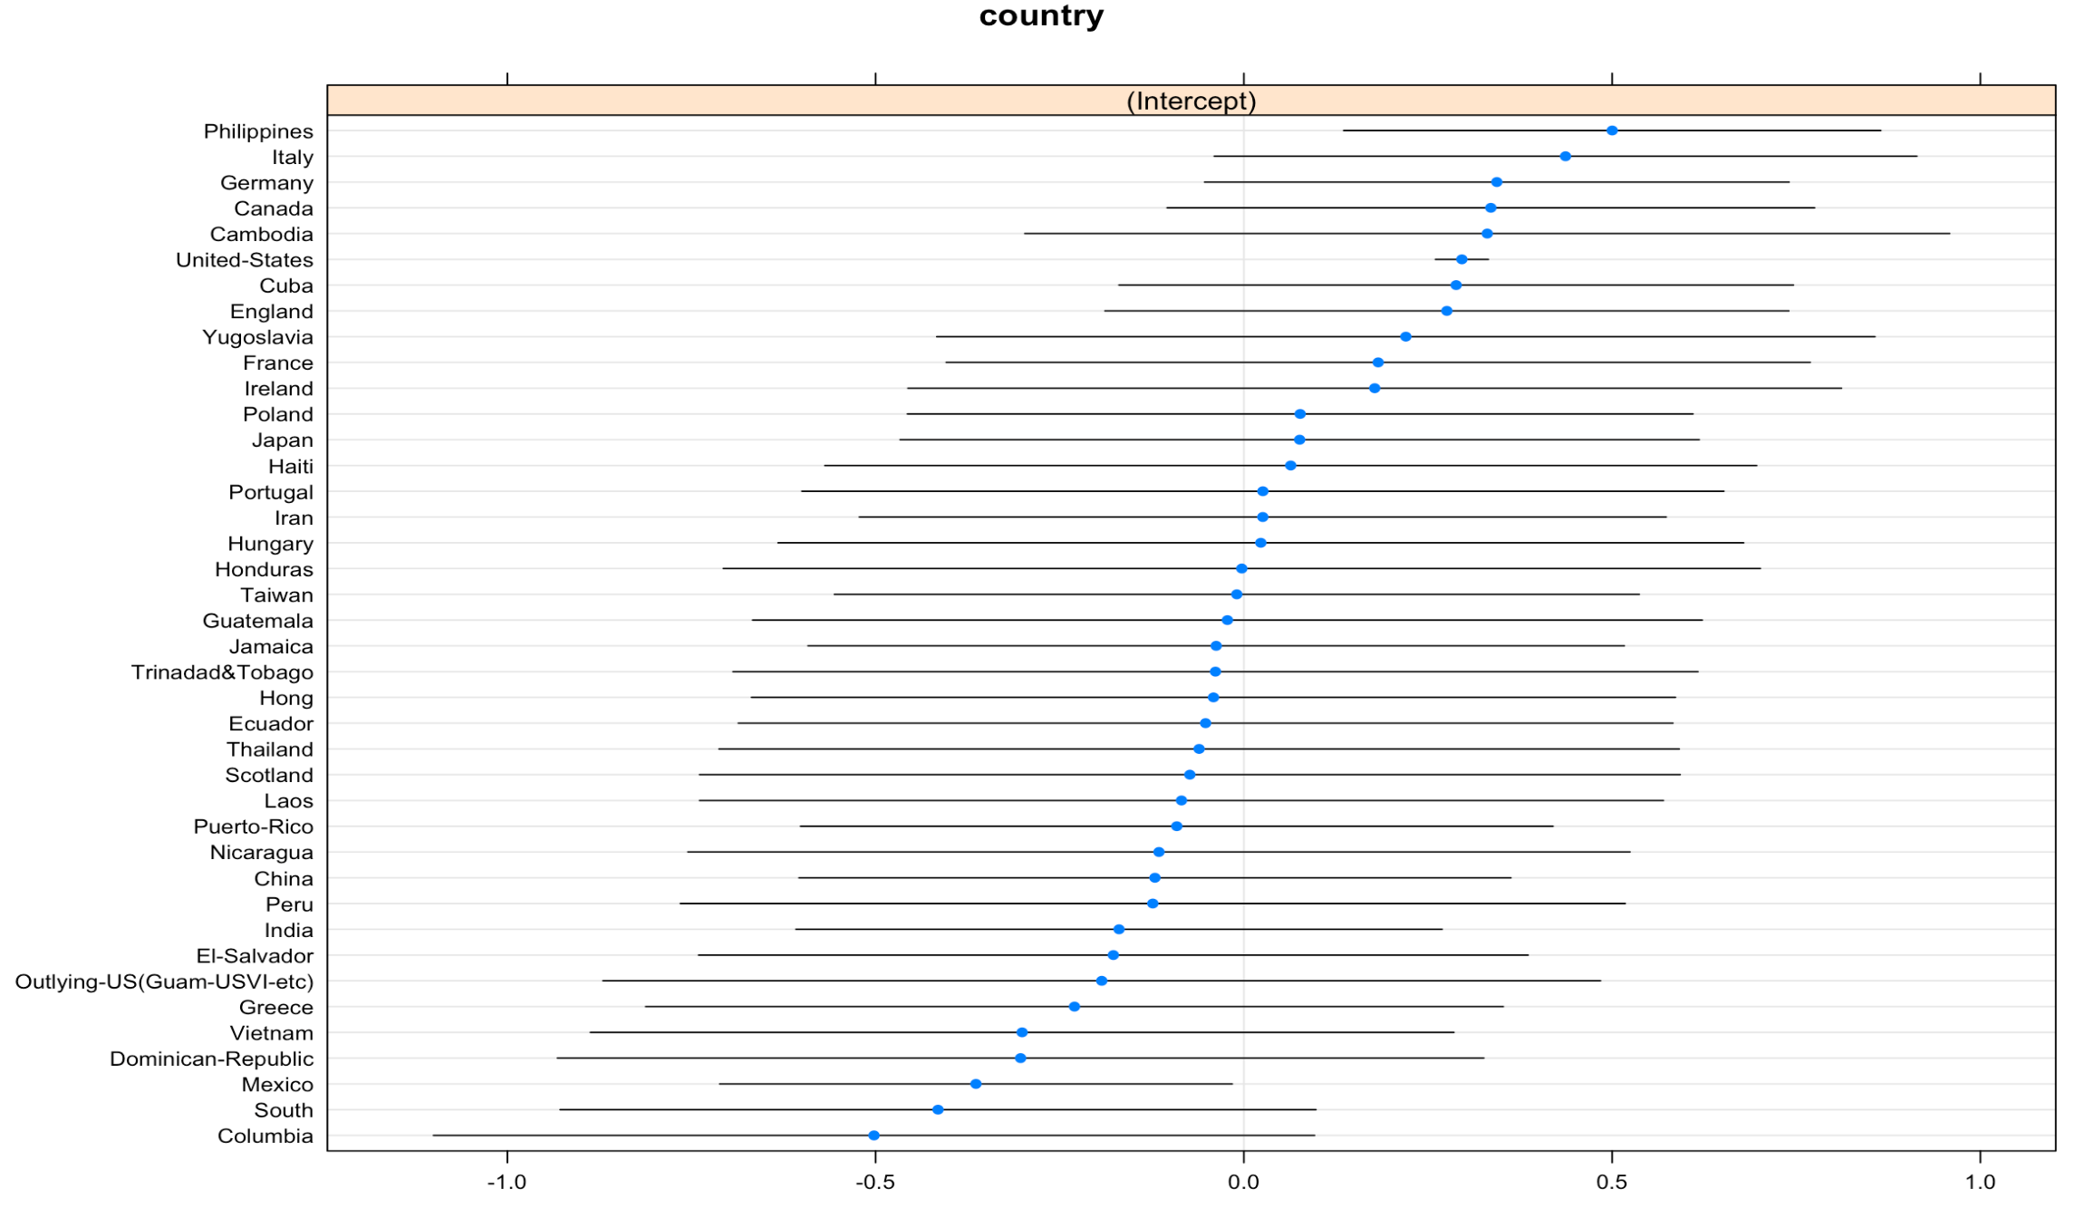
Results
country(intercept) std. Dev 0.37

Slide 7
>> $ 50,000
Yuwei Zhang
Thanks!

